Slide 1
RFID Jukebox Player
Justin Sparks
Cayson Greene

Slide 2
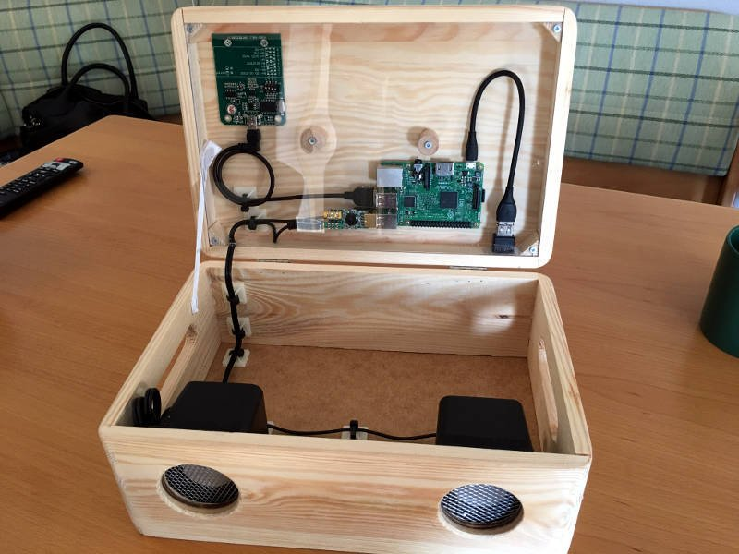
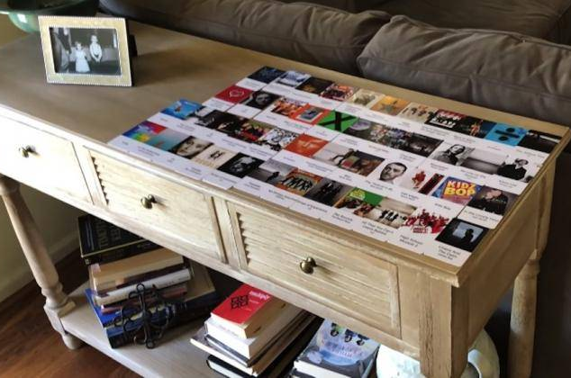
WHAT IS IT? How does it work? What does it do?
A contactless jukebox for the Raspberry Pi, playing audio files, playlists, podcasts, web streams, and Spotify triggered by RFID cards. Based off of MiczFlor Github Repository, our hopes in this project are to create an RFID chip reader that will take registered keys (albums or music) and in turn play the designated track specific to that key. Each key will be given a specific track list or album set library.

